Slide 1
Software Engineering
Lecture #20
Fakhar Lodhi

Slide 2
Recap

Slide 3
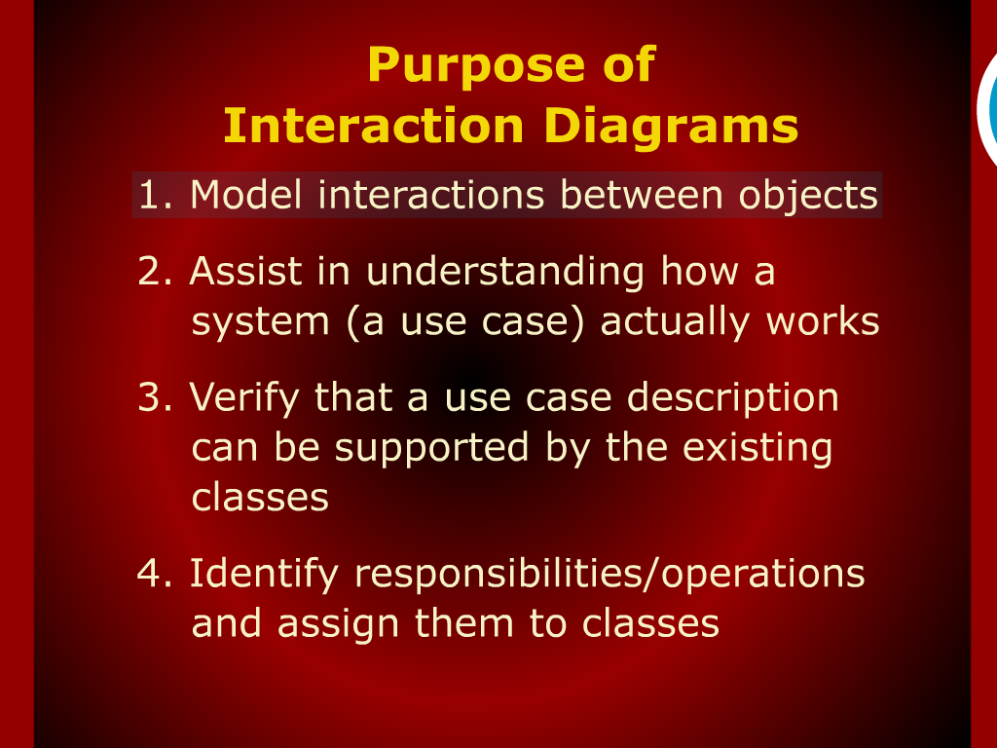
Purpose of Interaction Diagram

Slide 4
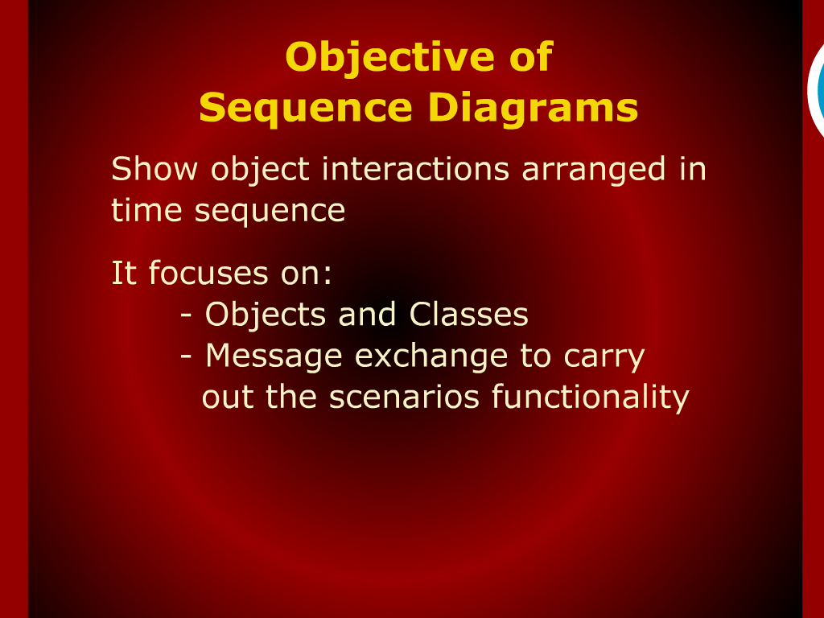
Objective of Sequence Diagram

Slide 5
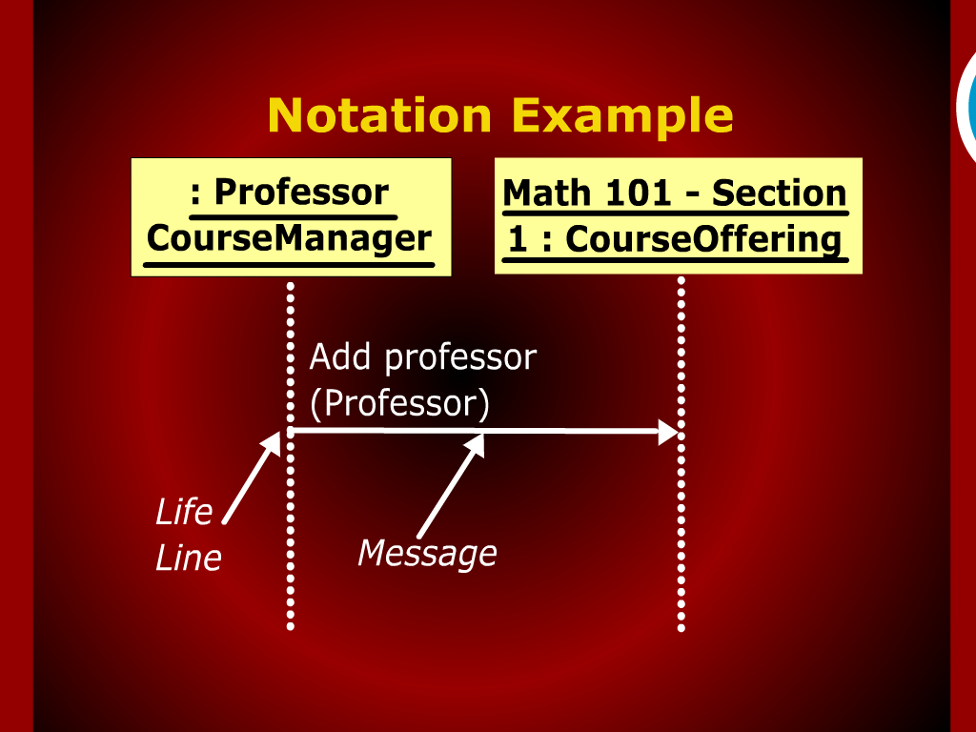
Notation Example

Slide 6
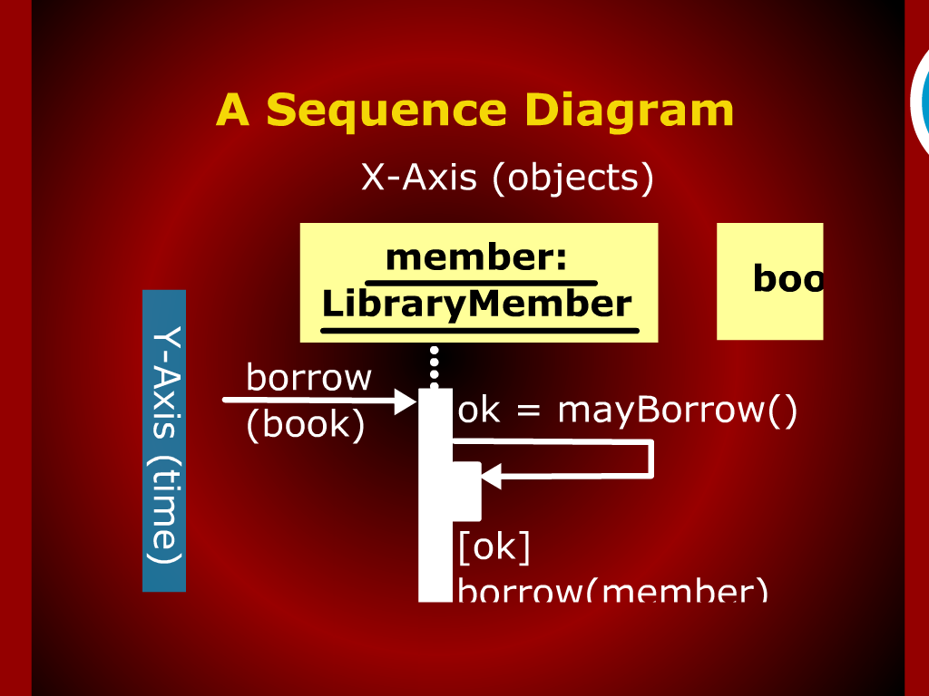
A Sequence Diagram

Slide 7
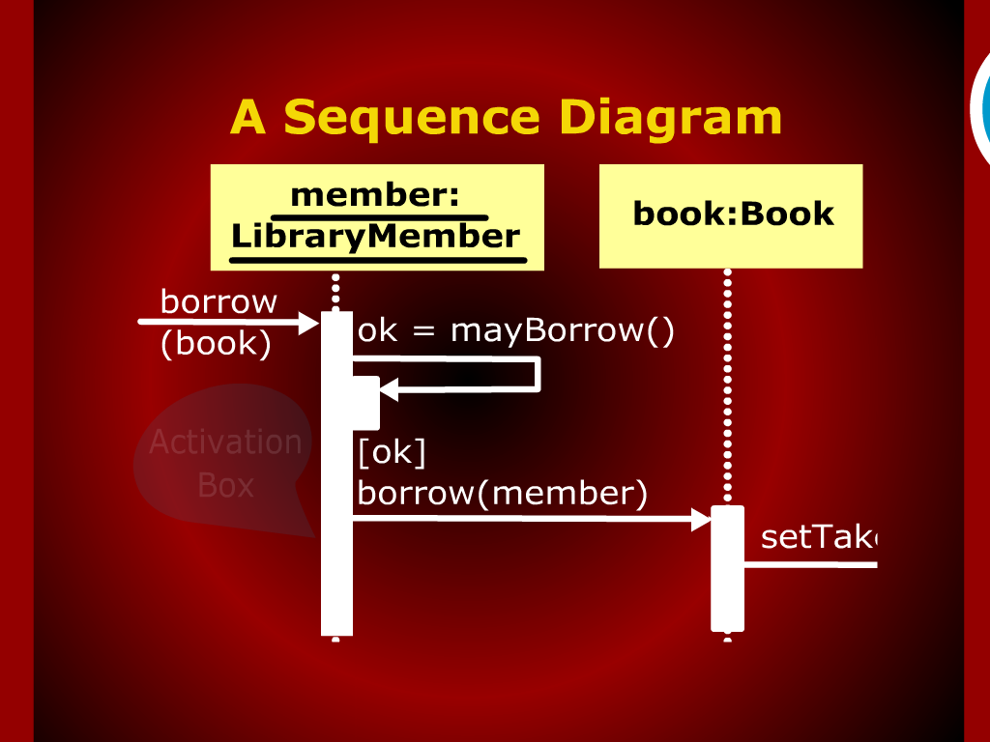
A Sequence Diagram

Slide 8
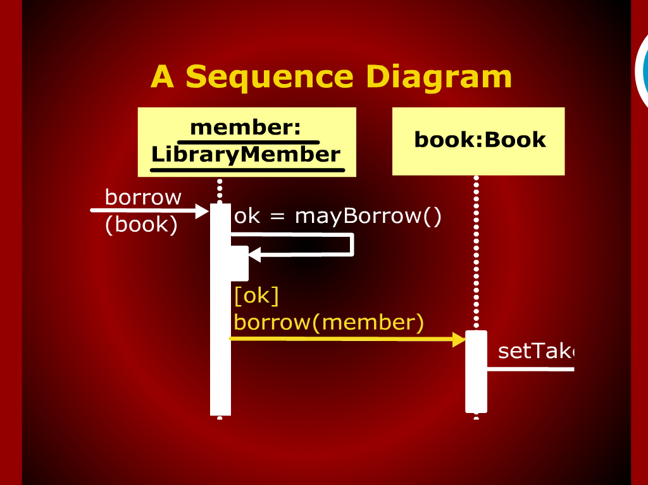
A Sequence Diagram

Slide 9
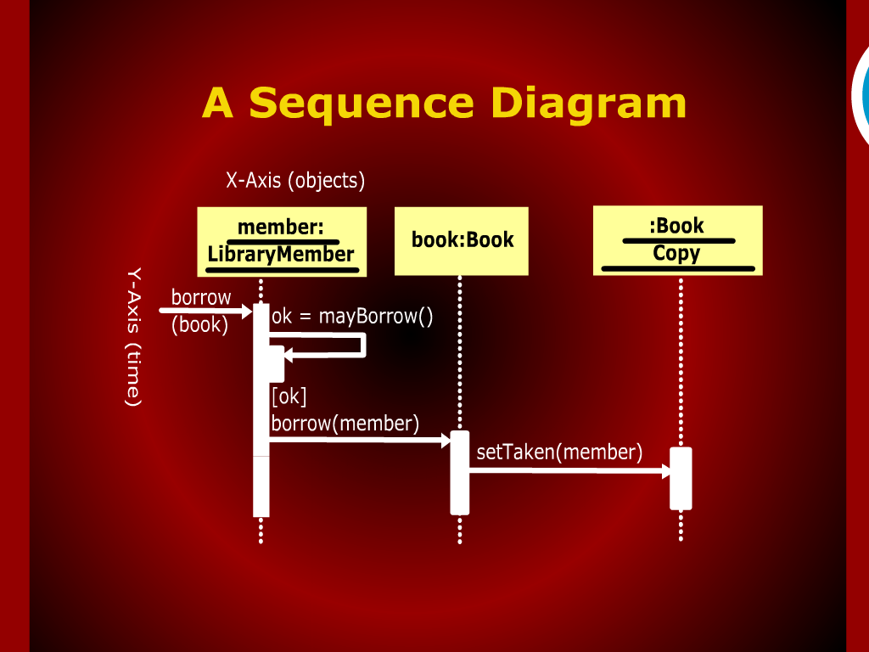
A Sequence Diagram

Slide 10
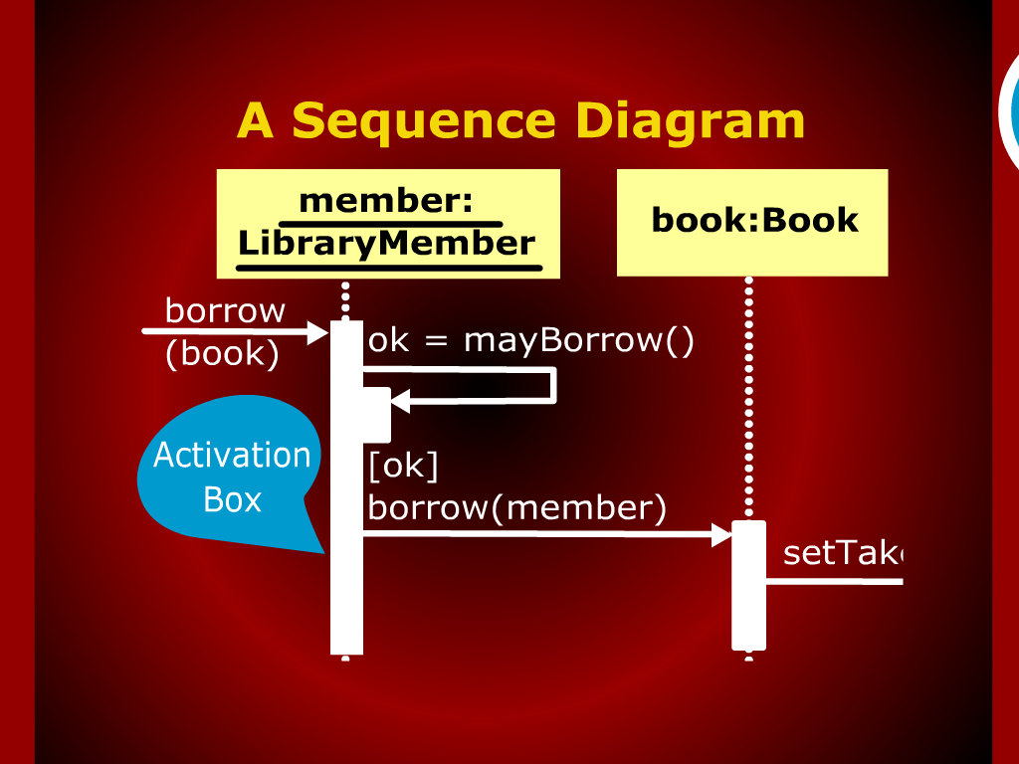
A Sequence Diagram

Slide 11
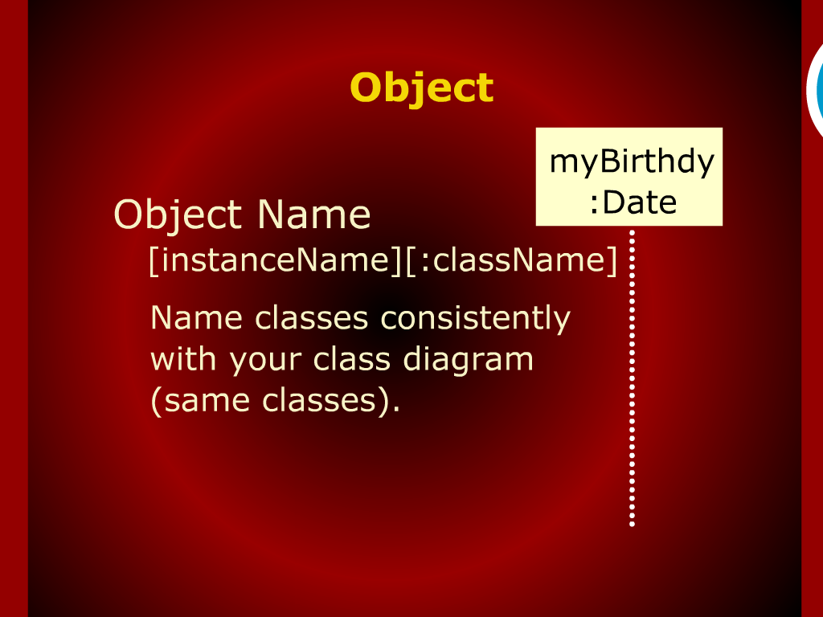
Object

Slide 12
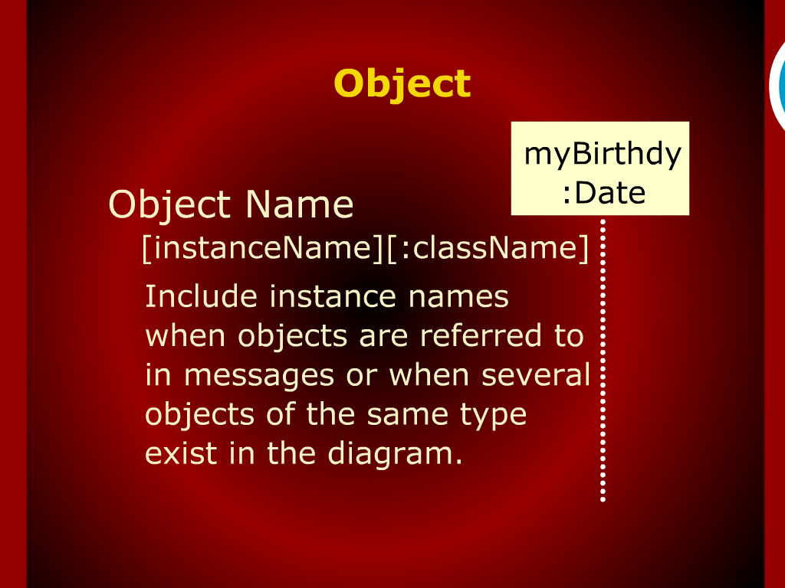
Object

Slide 13
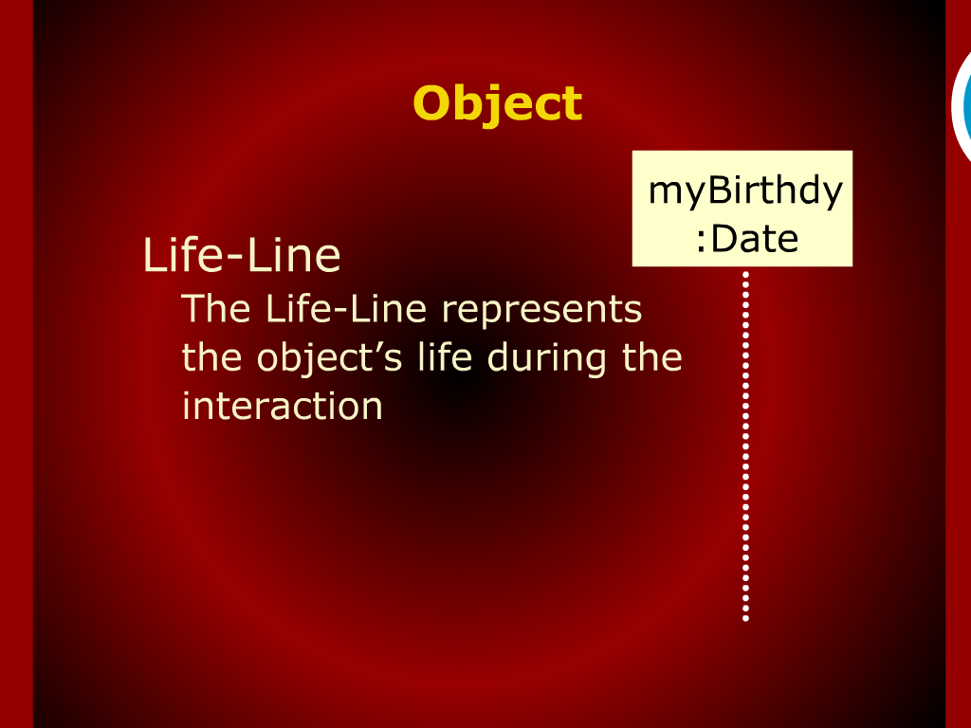
Object

Slide 14
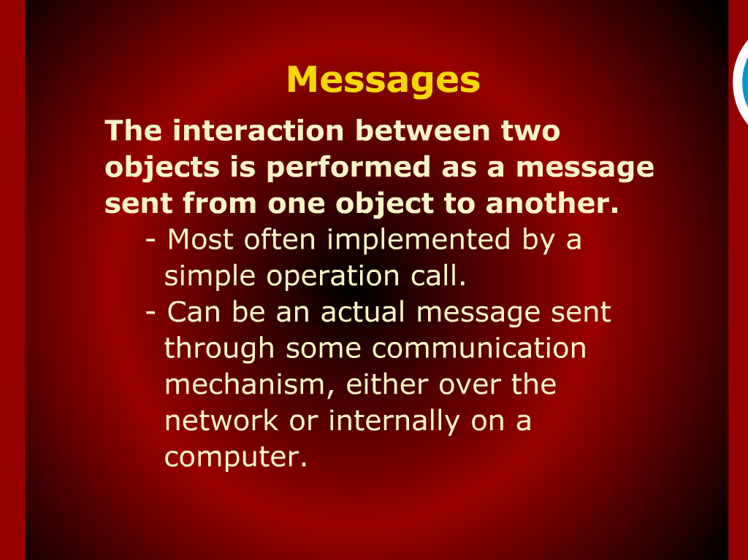
Messages

Slide 15
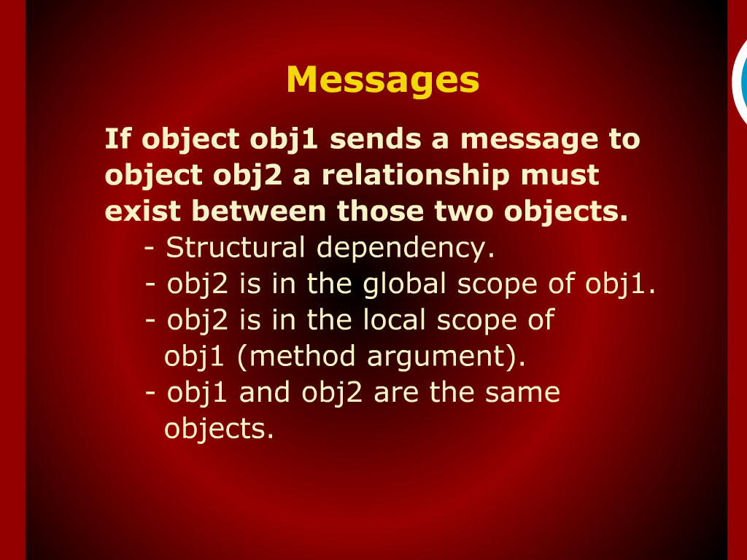
Messages

Slide 16
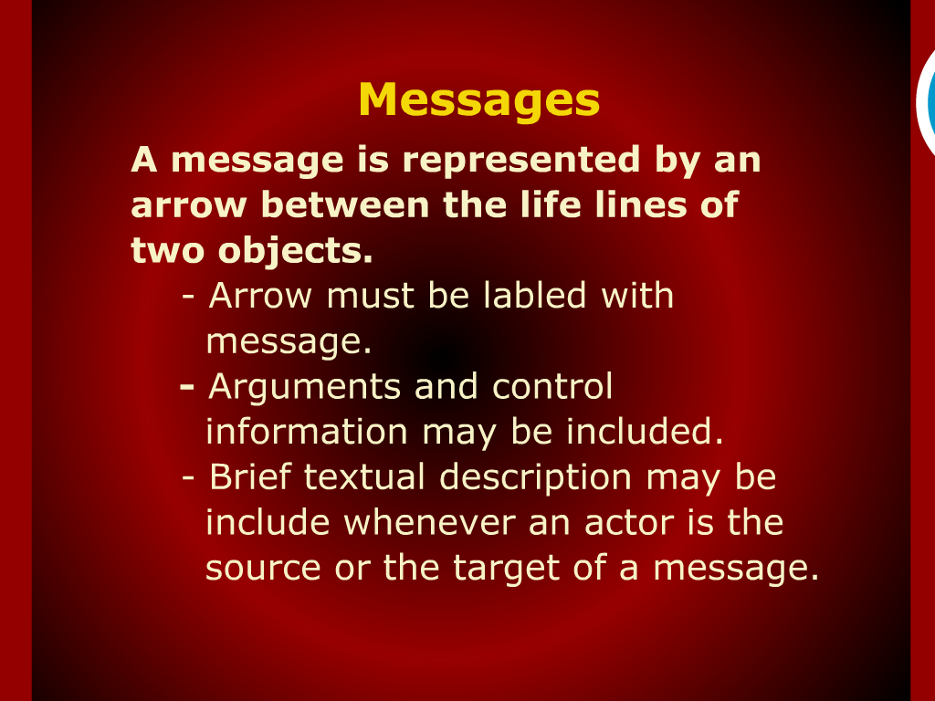
Messages

Slide 17
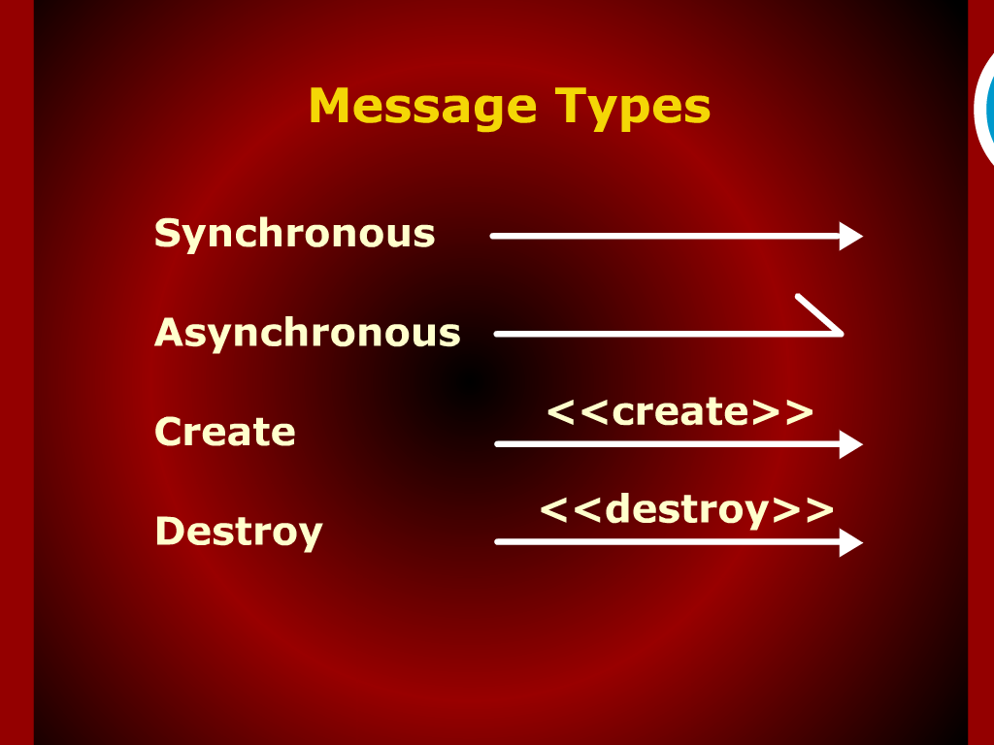
Message Types

Slide 18
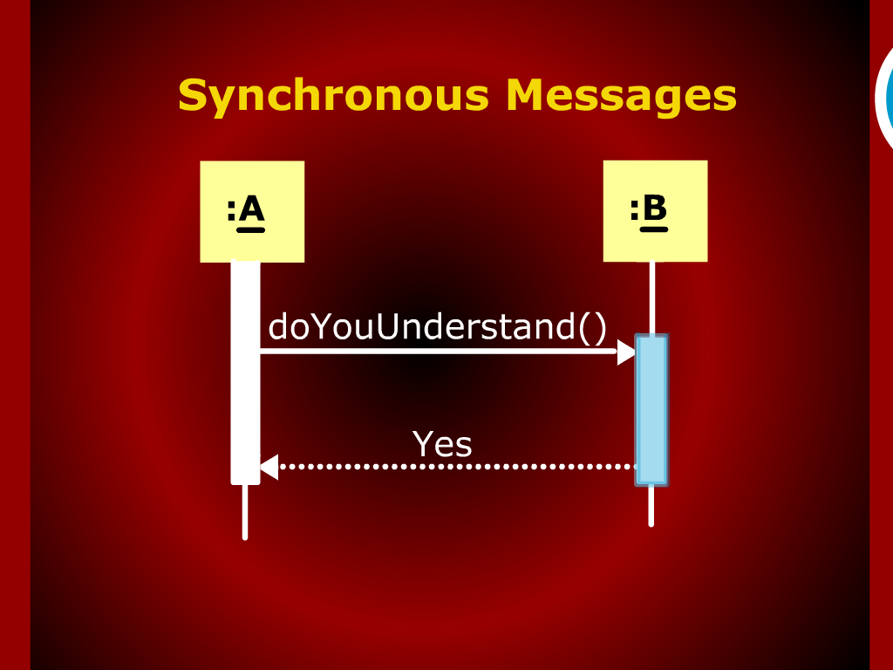
Synchronous Messages

Slide 19
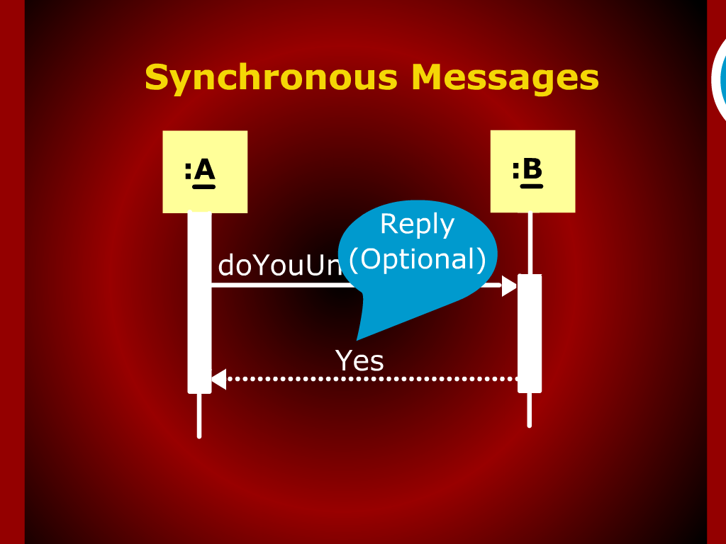
Synchronous Messages

Slide 20
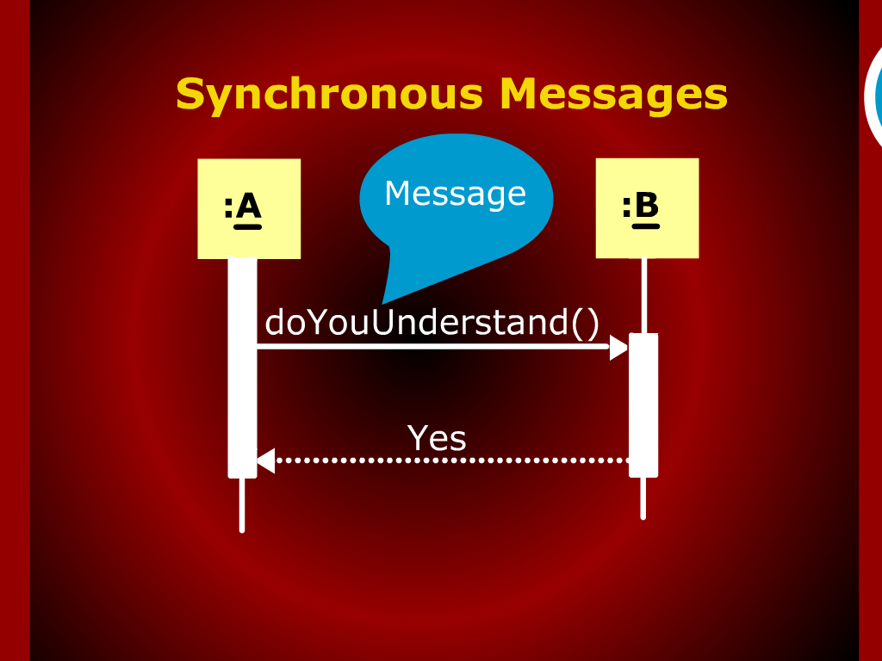
Synchronous Messages

Slide 21
Recap

Slide 22
Sequence Diagrams

Slide 23
Contents of Sequence Diagrams

Slide 24
Summary of Today’s Discussion

Slide 25
Interaction diagrams

Slide 26
Messages

